Slide 1
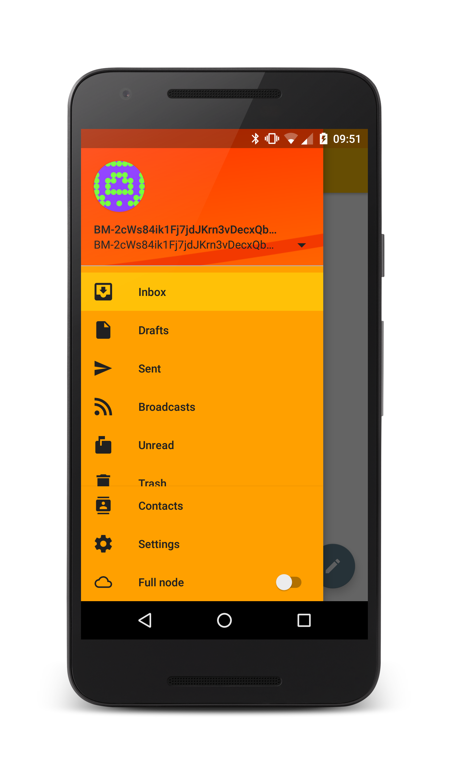
What is it about?
If you don't want anyone snooping in your e-mails you might already encrypt your correspondence. But you still can't hide who you're writing to, and your e-mail client might even reveal much more about you, your computer, and the software you use. Bitmessage attempts to solve all this, but up until now there was no practical way to use it on mobile phones, which might be a downside when you're on the run.
Bitmessage provides some unique challenges for mobile clients. Its users tend to be bordering on paranoia, or as often might really be tracked. The protocol is as wasteful as a hen, it needs both immense amounts of traffic and a lot of CPU time. It works by distributing every message to every client, so they can pick up the ones they can decrypt with the available private keys. To protect the network from malicious flooding, a proof of work is required, which is done by calculating a partial hash collision. So typically you'd want as many CPU cores as possible, no shortage of electricity and a flat rate on internet access – not quite the prefect basis for a mobile app.
Scan this QR code to get more .
information about the app .
The App
Bitmessage
Bitmessage is a peer to peer messaging protocol that builds a mesh network among the participating clients. Every client tries to maintain multiple connections to other network nodes and has a full copy of every current object.
Objects are encrypted using a public key. Every client tries to decrypt each new object using its private keys, processing the ones where it succeeds.
A big advantage of Bitmessage is its inherent key management. The address contains a hash of the public key, and retrieving said key is an integral part of the protocol. The way addresses look is a disadvantage that ensues:
BM-2cWs84ik1Fj7jdJKrn3vDecxQbH9R4VS9r
BM-2cUau5uxBYCK2Z2TVwUZnnNfYW5yyutekC
The app looks just like any e-mail app, apart from two specialities: the identity in the orange part on top, and the switch called ‘full node’ at the bottom. The first is how addresses look like in Bitmessage, and the latter starts the resource hungry connection to the Bitmessage network.
An Android Client for Bitmessage
Graduate: | Christian Basler
Professor: | Dr. Kai Brünnler
Expert: | Daniel Voisard
Bachelor Thesis 2015/16 Division of Computer Science

